Slide 1


Deep Learning-Based Pneumothorax Segmentation for Clinical Decision Support
Presented by: Mudra Bhedi (U22EC002)
Shubham Kamble (U22EC011) Jiya Parmar (U22EC058) B.Tech IV, 7th Semester
Guide: Dr. Jignesh N. Sarvaiya

Slide 2
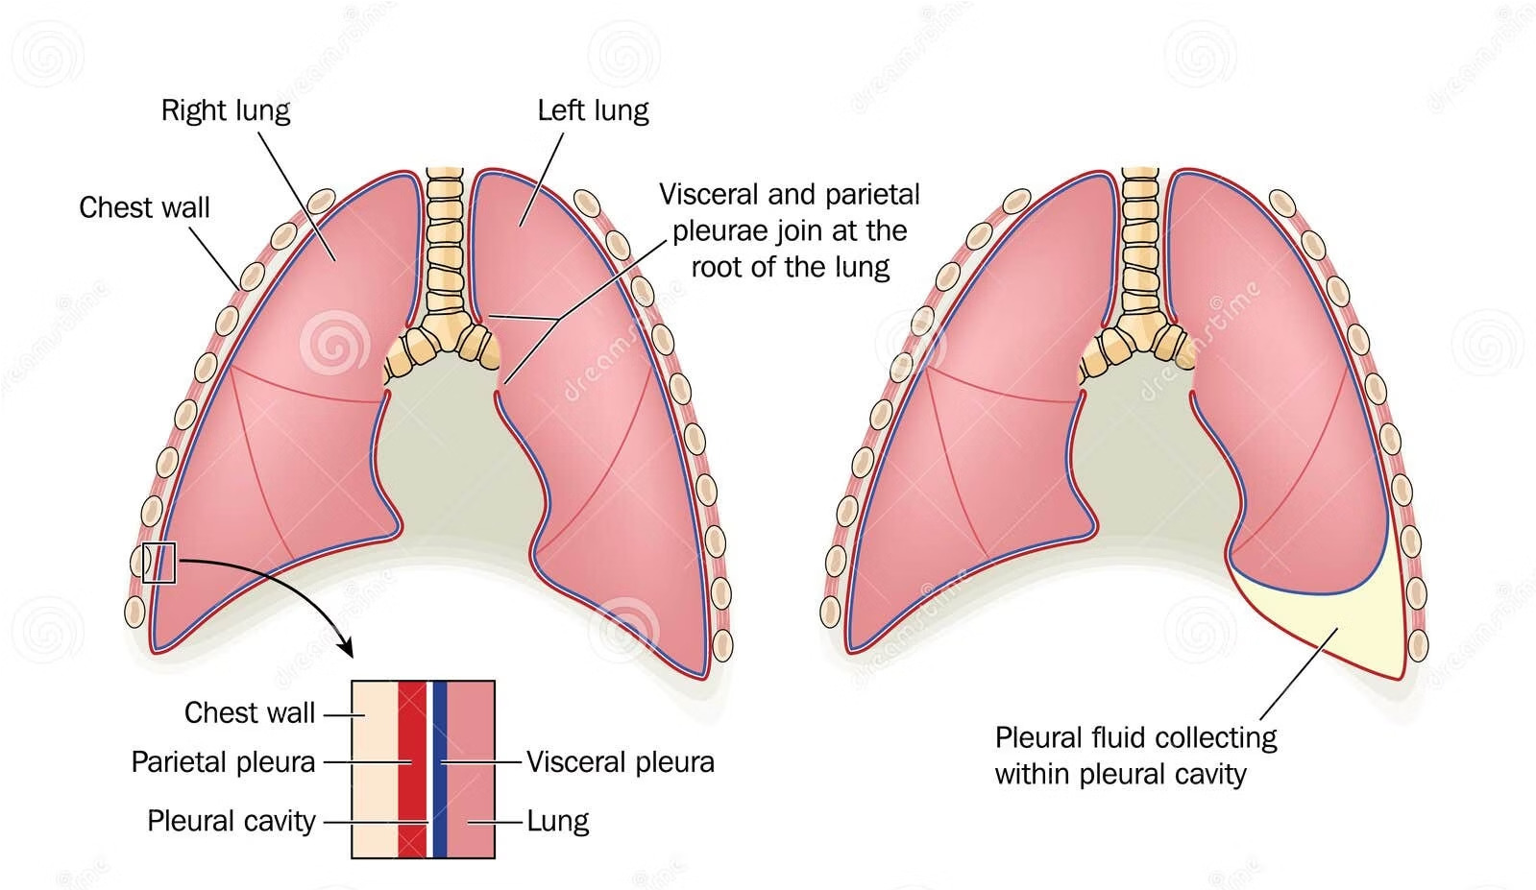
What is Pneumothorax ?
Pneumothorax refers to the abnormal accumulation of air inside the pleural space, causing lung collapse. Early and accurate detection is essential because delayed diagnosis leads to respiratory distress, hemodynamic instability, and, in severe cases, fatal tension pneumothorax. Chest X-rays are the primary diagnostic tool, but subtle radiographic findings make detection difficult, especially in emergency or high-workload settings.
Clinical Significance
Partial or complete lung collapse Respiratory compromise and hypoxemia Potential hemodynamic instability
Up to 50% initially overlooked on X-rays
Radiographic comparison of a healthy lung and a lung collapsed due to pneumothorax.

Slide 3
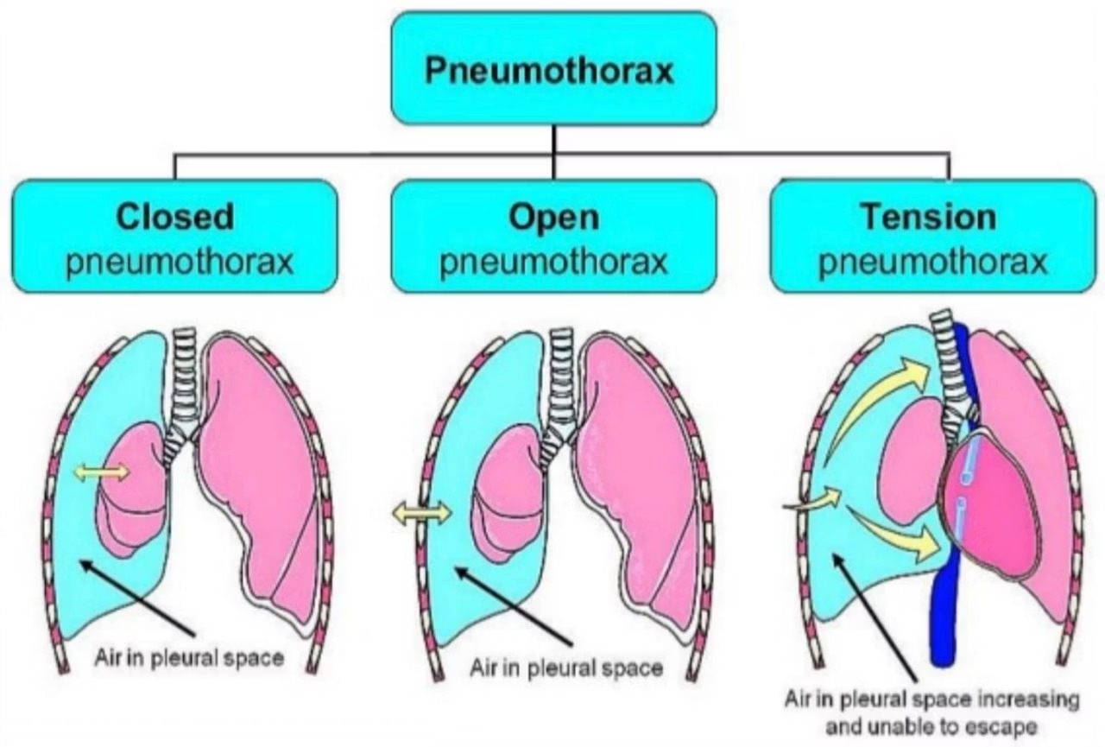
Types of Pneumothorax:
Spontaneous Pneumothorax
Air enters pleural space without trauma Primary (no underlying lung disease) Secondary (from COPD, cystic fibrosis, etc.)
Traumatic Pneumothorax
Results from chest trauma (blunt or penetrating injury) Can occur immediately or be delayed
Tension Pneumothorax
Air accumulates in pleural space with one-way valve effect
Causes progressive lung collapse and hemodynamic compromise
Medical emergency requiring immediate intervention
Classification of pneumothorax based on its mechanism and clinical behavior

Slide 4
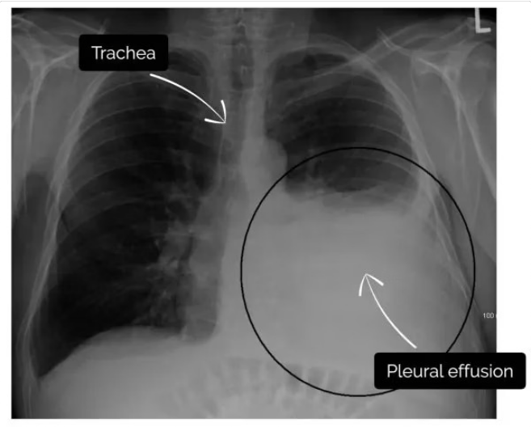
Challenges in Radiographic Diagnosis:
Chest X-ray is widely used for pneumothorax diagnosis but has several limitations:
Subtle appearance: The pleural line is often faint, especially in small pneumothoraces.
Structural overlap: Ribs, clavicle, and soft tissues obscure critical boundaries.
Supine X-rays: Air collects anteriorly/basally, making detection even harder in trauma cases.
Low contrast & artifacts: Poor exposure, motion blur, skin folds, and medical devices mimic pneumothorax.
High clinical workload: Radiologists frequently miss subtle cases; up to 50% are overlooked on initial reading.

Slide 5
What is the Motivation?

Slide 6
Clinical Motivation
Clinical Urgency
Clinical Decision Support
Pneumothorax can worsen quickly, making early detection and intervention critical.
It is a time-sensitive emergency that requires rapid triage.
Accurate segmentation enables reliable pneumothorax severity quantification.
Directly supports key clinical decisions such as:
Observation
Needle aspiration
Chest tube placement
Radiologist Workload Challenge
Emergency departments face heavy imaging loads, especially during nights and mass-casualty periods.
Fatigue contributes to missed findings4up to 50% of pneumothoraces are initially overlooked.
AI tools can flag high-risk cases, helping prioritize urgent studies.
Standardization & Workflow Integration
Automated segmentation reduces inter-observer variability and improves consistency.
Provides standardized severity assessment across different clinicians.
Integrates smoothly into existing PACS workflows without adding to radiologist workload.
Helps accelerate decision-making in time-sensitive emergency situations.
Efficiency Gains
AI-assisted triage reduces reporting time from 186 minutes to 100 minutes. Faster turnaround improves clinical workflow and patient outcomes.

Slide 7
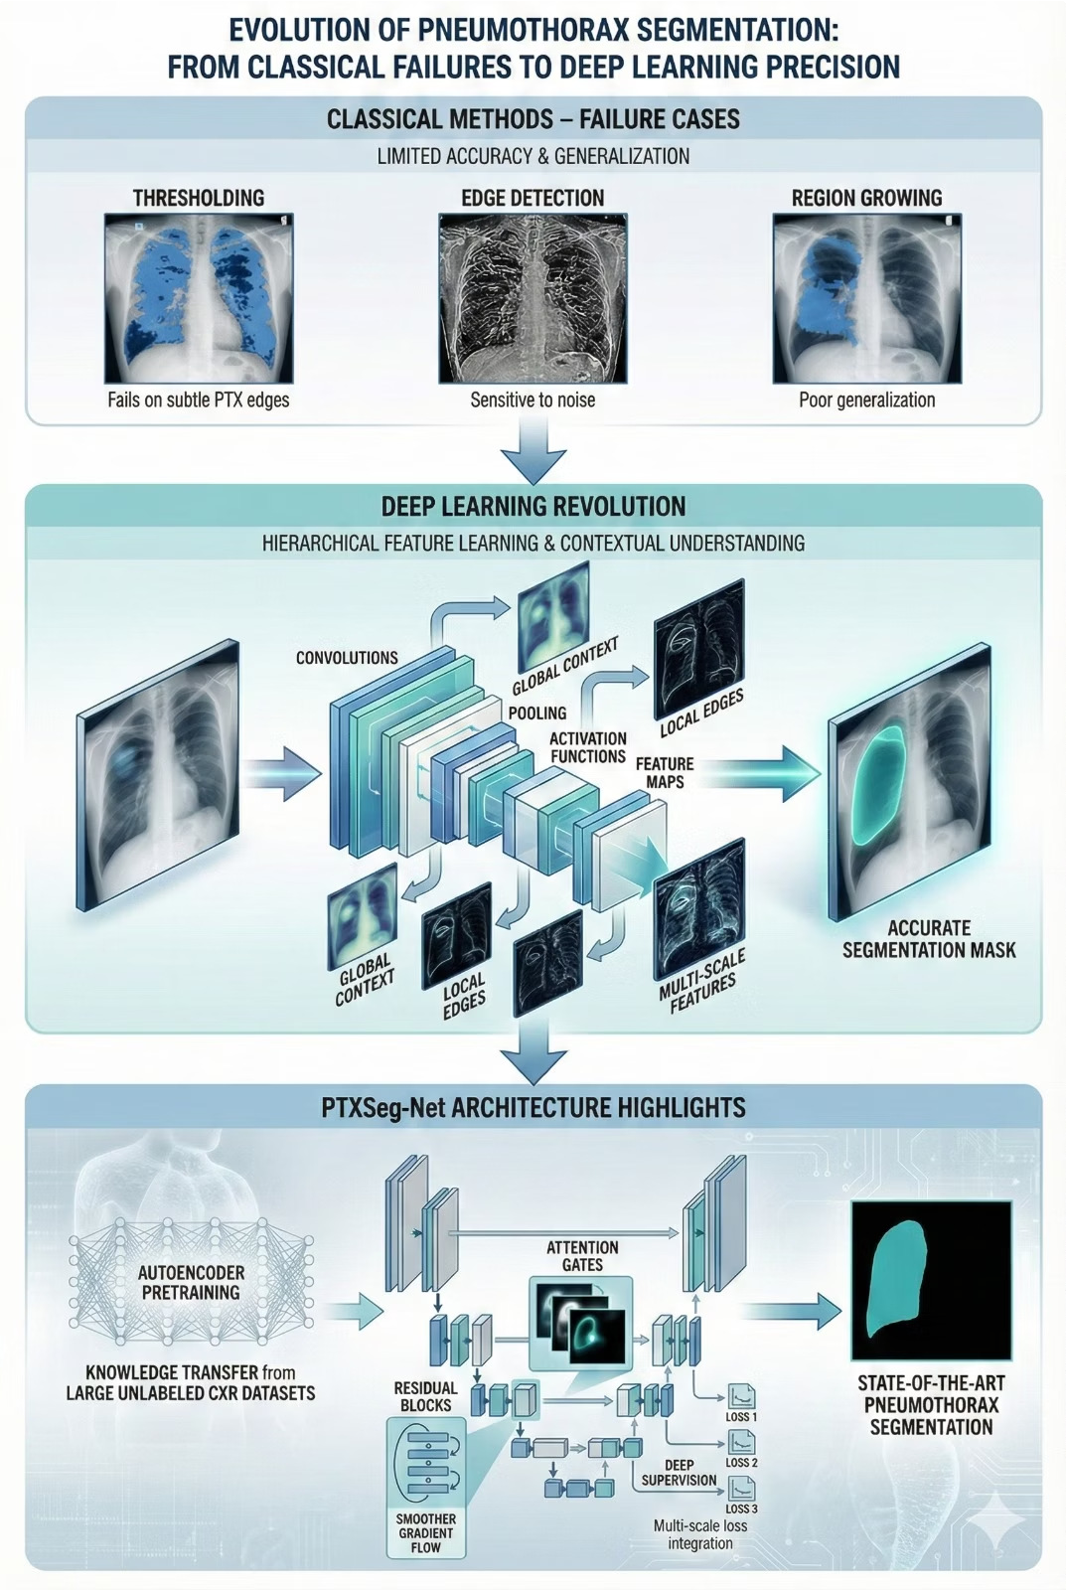
Technical Motivation
Limitations of Classical Methods
Techniques like thresholding, edge detection, and region growing fail to generalize due to:
Low contrast and noise in chest X-rays
Overlapping anatomical structures
Subtle and irregular pneumothorax boundaries
Advantages of Deep Learning Methods
Deep learning automatically learns hierarchical features from raw CXRs, enabling models to:
Capture global anatomical context Detect subtle local pleural edges
Learn multi-scale features across resolutions
Handle severe class imbalance between lung and pneumothorax regions
Why PTXSegINet? OArchitectural ImprovementsP
PTXSeg-Net integrates several modern enhancements:
Residual Blocks: Improve gradient flow and stability in deeper networks
Attention Gates: Highlight pneumothorax-relevant regions while suppressing irrelevant features
Deep Supervision: Ensures multi-scale consistency across decoder outputs
Autoencoder Pretraining: Provides domain-specific initialization using large unlabeled CXRs

Slide 8
Project Objectives
Research-Oriented:
Analyze limitations of traditional segmentation techniques.
Examine modern deep-learning architectures for pneumothorax segmentation.
Understand domain challenges in chest radiography.
Technical-Oriented:
Build a robust U-Net-based segmentation architecture enhanced with residual connections, attention gates, and deep supervision
Apply autoencoder pretraining for domain-sensitive initialization.
Implement test-time augmentation (TTA) and snapshot ensembling for prediction stability.
Clinical-Oriented:
Evaluate segmentation performance using clinically relevant metrics (Dice, IoU, Sensitivity).
Compute pneumothorax severity using area ratios correlating with standard guidelines (BTS, ACCP).
Enable interpretability through visual overlays for radiologists.

Slide 9
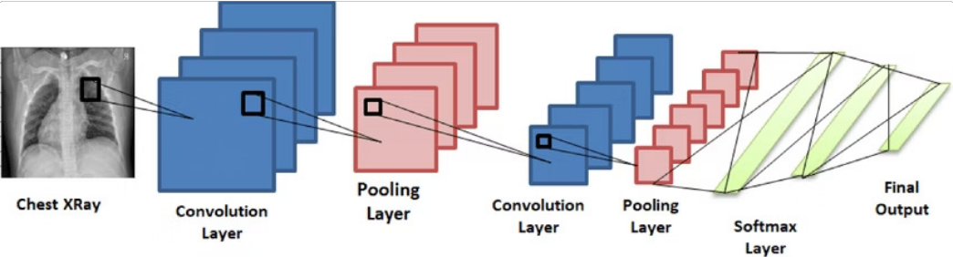
Why CNNs in Medical Image Processing?
A Convolutional Neural Network (CNN) is a deep learning architecture designed to automatically learn spatial patterns from images using convolutional filters.
Advantages in Medical Imaging
Local Feature Extraction: Detects fine edges, textures, lesions, and anatomical boundaries.
Hierarchical Representation: Learns organ-level and abnormality-level structures across deeper layers.
Robust to Variability: Handles noise, contrast changes, patient posture differences, and imaging artifacts.
Parameter Efficiency: Weight sharing reduces parameters, making CNNs effective even with limited medical datasets.
Consistency & Objectivity: Produces reproducible, unbiased results, reducing human interpretation errors.

Slide 10
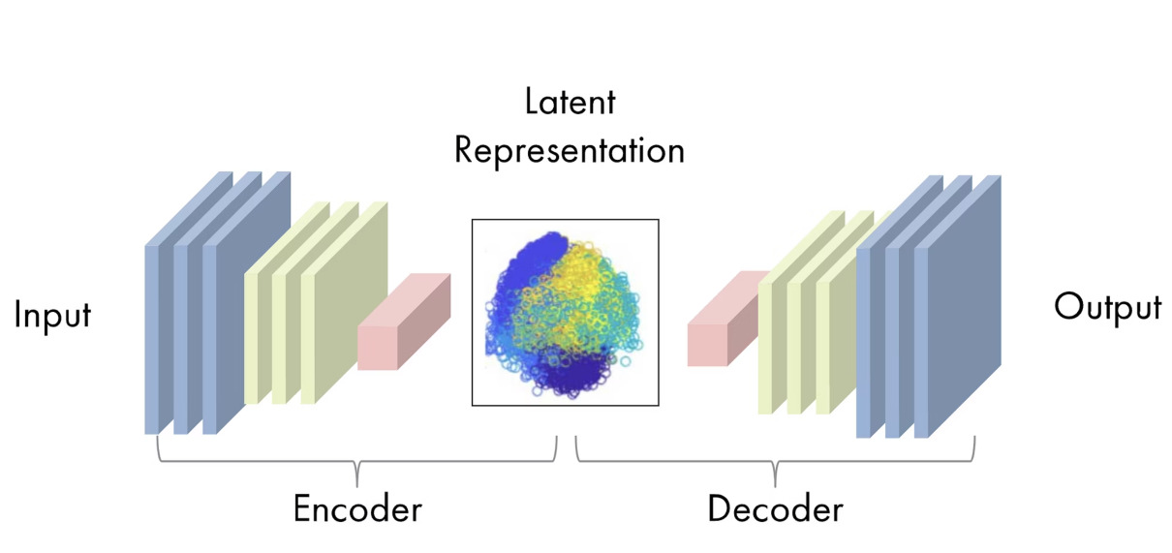
Why Autoencoders in Medical Imaging?
An Autoencoder is a type of neural network designed to learn compressed (latent) representations of input data by encoding it into a lower-dimensional space and then reconstructing the original image from that representation.
Benefits of Autoencoder Pretraining
Learns rib distribution patterns and other repeating anatomical structures
Captures lung shapes and pleural boundaries, improving spatial understanding
Provides encoder weights aligned with the radiography domain, unlike ImageNet
Reduces dependence on limited labeled medical data Accelerates convergence during segmentation training
Enhances performance in noisy, low-contrast, or ambiguous regions
How It Works
Encoder: Compresses the input image into a compact latent vector
Latent Space: Stores essential structural features
Decoder: Reconstructs the original image from the latent vector

Slide 11
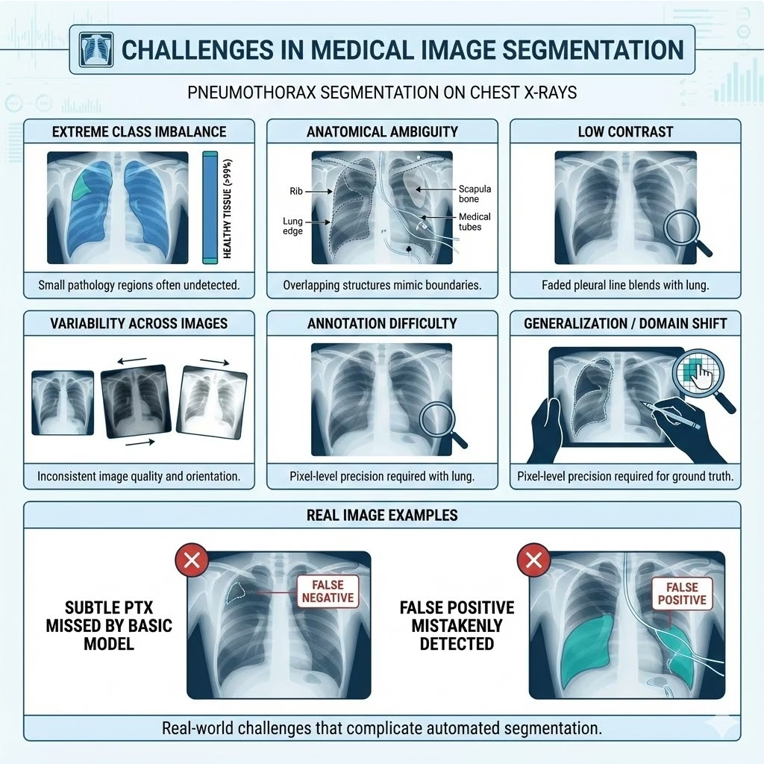
Challenges in Medical Image Segmentation
Extreme Class Imbalance: Pneumothorax regions often occupy <1% of the image, making training unstable.
Anatomical Ambiguity: Overlapping ribs, scapulae, medical devices, and tubes obscure pleural boundaries.
Low Contrast: Pneumothorax edges frequently blend into the surrounding thoracic tissues.
High Variability: Differences in patient posture, projection angles, and exposure settings affect model consistency.
Annotation Difficulty: Creating pixel-level masks requires expert radiologists and is time-consuming.
Poor Generalization: Models trained on SIIM-ACR may underperform on external hospital data due to domain shift.

Slide 12
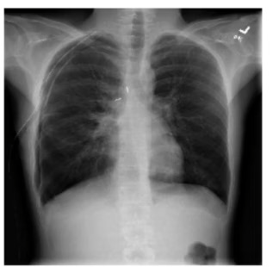
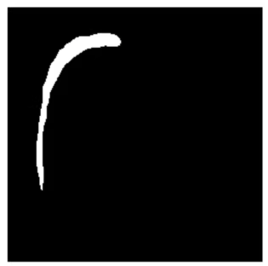
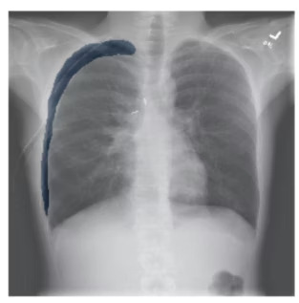
SIIM-ACR Pneumothorax Dataset Overview
Dataset Characteristics
12,000+ chest X-rays with expert annotations
Pixel-level pneumothorax masks for supervised segmentation
Includes AP and PA projections, covering a wide range of ages and clinical presentations
Quality & Preprocessing Needs
Annotation quality varies, requiring label refinement for cleaner training masks Designed to capture real-world clinical variability
Research Significance
Official dataset of a Kaggle medical imaging challenge
Widely used in academic and clinical research for benchmarking segmentation models Provides a standardized testbed, enabling fair comparison of deep learning architectures

Slide 13
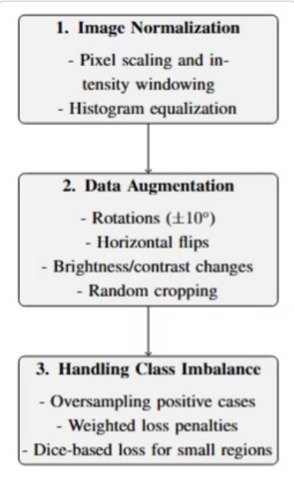
Preprocessing Pipeline:
Image Normalization:
Pixel scaling, intensity windowing to emphasize lung fields Histogram equalization
Data Augmentation:
Rotations (±10°) to mimic positioning variations Flips for anatomical symmetry
Brightness/contrast changes simulating exposure variations Random cropping to improve robustness
Handling Class Imbalance:
Oversampling positive pneumothorax cases Weighted loss penalties
Dice-based loss improves segmentation of small regions

Slide 14
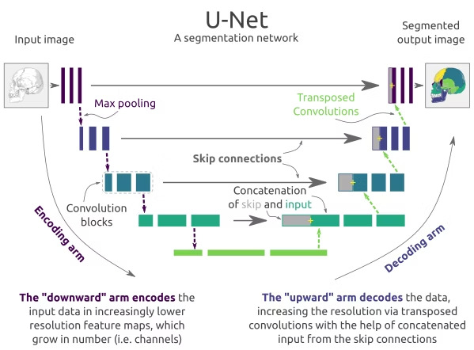
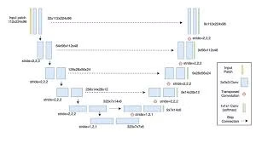
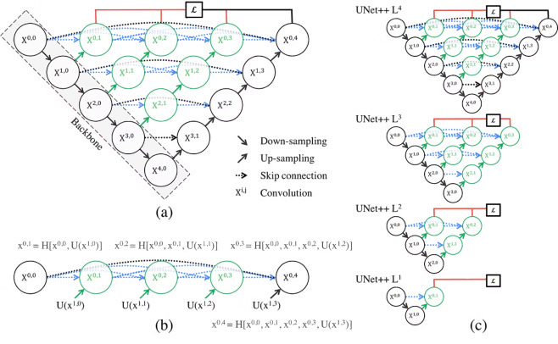
U-Net Architecture Comparison
U-Net
The foundational convolutional neural network for biomedical image segmentation, known for its strong performance with limited training data.
Key Features :
Symmetrical encoder-decoder structure.
Skip connections concatenate feature maps from encoder to decoder, preserving fine-grained details.
Allows for precise localization and context learning.
Advantages :
Effective for segmenting structures with clear boundaries.
Good baseline for rapid deployment and initial analysis. Requires less data compared to other architectures.
U-Net++
An improved U-Net architecture that bridges the semantic gap between the encoder and decoder through a nested, dense skip connection pathway.
Key Features :
Nested and dense skip pathways for richer feature aggregation.
Redesigned skip connections reduce semantic discrepancy.
Offers flexibility in network depth and receptive field.
Advantages :
Enhanced segmentation accuracy for complex and variable lesion shapes.
Better handling of diverse pneumothorax presentations due to improved feature fusion.
Addresses limitations of standard U-Net in capturing multi-scale features.
nnU-Net
A "no-new-UNet" framework that provides a robust and self- configuring approach to achieve state-of-the-art medical image segmentation without manual tuning.
Key Features :
Automated configuration (pre-processing, network topology, training parameters).
Ensemble of optimized 2D, 3D, and cascade U-Nets. Data-driven approach, adapting to diverse datasets.
Advantages :
Achieves top performance with minimal effort for specific datasets.
Highly adaptable and robust across different imaging modalities and clinical settings.
Reduces expert intervention, accelerating development of pneumothorax detection tools.

Slide 15
Why Use Different Encoders?
Deep learning encoders act as feature extractors, capturing anatomical patterns from chest X- rays. Choosing the right encoder significantly impacts segmentation accuracy, generalization, and computational efficiency.

Slide 16
Encoders Used
ResNetI34
Balanced depth and efficiency
Strong baseline for medical imaging tasks
ResNetI50
High-capacity encoder for detailed feature extraction
Performs well on complex segmentation cases
Why Multiple Encoders?
To compare accuracy vs. computational cost
To evaluate generalization across architectures
To identify the optimal encoder for pneumothorax segmentation
To understand how domain-specific pretraining (AE) improves result
EfficientNetIB0
Lightweight and fast Ideal for low-latency,
deployment-friendly models
Pretrained Autoencoder Encoder
Learned directly from chest X-ray reconstruction
Domain-adapted features superior to ImageNet pretraining
Provides better initialization for PTXSeg-Net
EfficientNetIB4
Deeper and more expressive
Captures rich contextual features

Slide 17
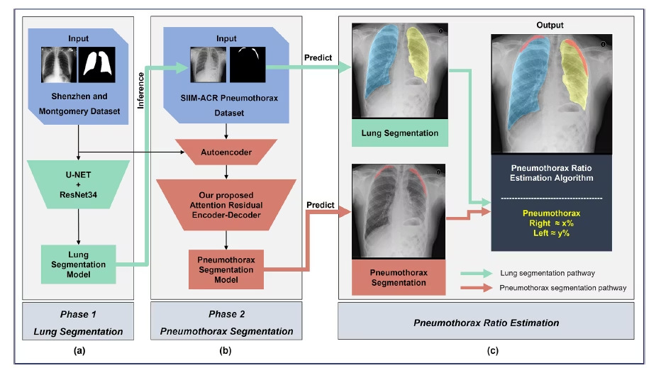
PTXSeg-Net Architecture
Residual Blocks
Improve gradient flow and training stability Enable deeper network design
Reduce issues like vanishing/exploding gradients
Attention Gates
Selectively highlight pneumothorax-relevant regions Suppress irrelevant background features
Enhance decoder focus on pleural boundaries
Deep Supervision
Produces auxiliary outputs at multiple decoder levels Encourages consistent multi-scale feature learning
Speeds convergence and improves fine-detail segmentation
Autoencoder-Initialized Encoder Pretrained on large unlabeled CXR data Provides domain-adapted initialization
Improves convergence, generalization, and low-contrast performance

Slide 18
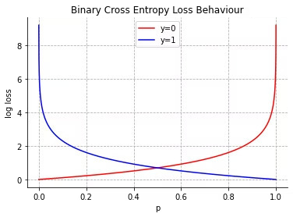
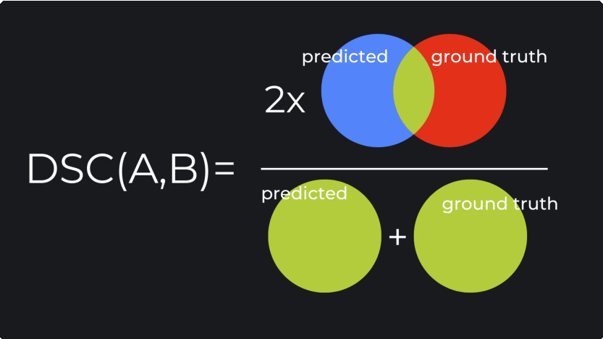
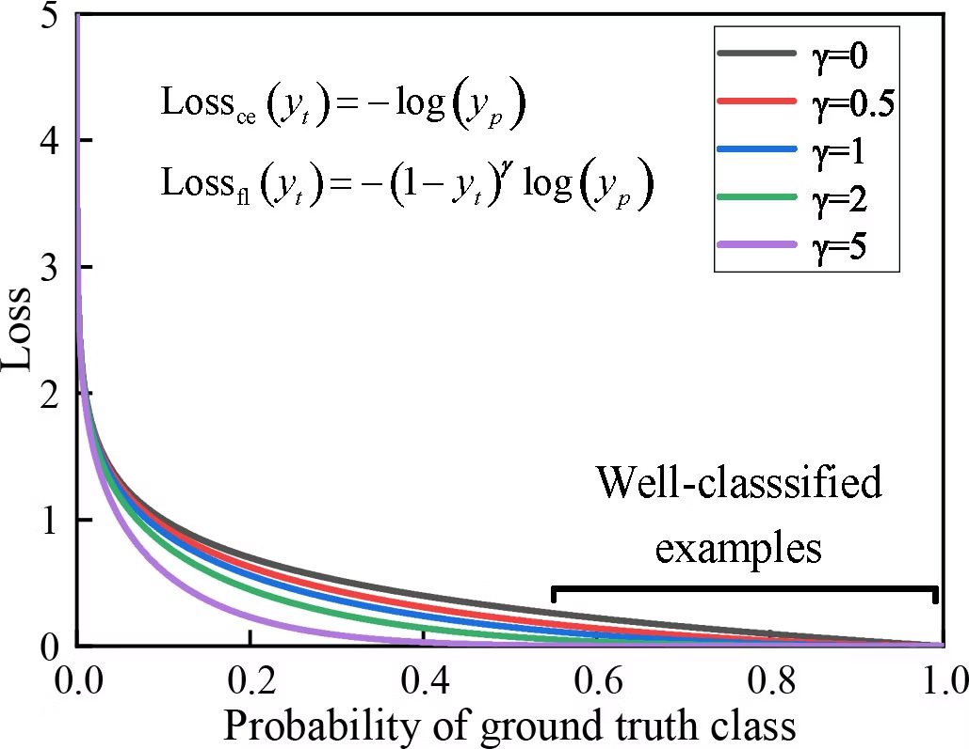
Loss Functions
Binary Cross Entropy (BCE) Pixel-wise classification loss; stable but sensitive to class imbalance.
Dice Loss Focuses on region overlap; highly effective for small
pneumothorax areas.
Focal Loss
Down-weights easy negatives and emphasizes difficult, ambiguous pixels.
Hybrid Loss (BCE + Dice)
Combines pixel-level accuracy with overlap-based optimization for robust convergence.

Slide 19
Evaluation Metrics Overview
Dice Coefficient
Measures overlap between predicted and ground-truth masks.
Sensitive to boundary quality.
Dice = 2 · |Prediction + Ground Truth| / (|P| + |GT|) Higher Dice ³ better segmentation accuracy.
Intersection over Union (IoU)
Also called Jaccard Index.
Represents the ratio of intersection to union of prediction and ground truth.
IoU = |P + GT| / |P , GT|
Complements Dice to evaluate mask quality.
Sensitivity (True Positive Rate)
Measures how effectively the system detects pneumothorax when it is actually present. Defined as: Sensitivity = TP / (TP + FN)
High sensitivity is essential in medical imaging because missing a pneumothorax can be clinically dangerous.
Used to assess the model9s value as a screening and triage tool.
Severity Quantification
Severity reflects how large the pneumothorax is relative to the lung. Computed as: Severity (%) = (Area of Pneumothorax / Area of Lung) × 100 Clinically important because management decisions depend on severity: Small ³ Observation
Moderate ³ Needle aspiration Large ³ Chest tube insertion
Ensures objective and standardized assessment across clinicians.

Slide 20
Experimental Setup
Training Strategy
Optimizer: Adam with learning rate scheduling
Loss Function: Combined Dice Loss + Binary Cross-Entropy
Regularization: Early stopping and model checkpointing
Enhancements:
Test-Time Augmentation (horizontal flips, slight rotations)
Snapshot ensembling for stable predictions
Evaluation Protocol
Metrics computed on an unseen test set to ensure unbiased performance.
Normalization: Input images standardized to 256×256 resolution with pixel intensity normalization
Evaluation Protocol: Metrics calculated on an unseen test set to ensure unbiased performance measurement
Dataset Split: 70% training, 15%
validation, 15% testing
Batch Size: 8–16
Hardware: NVIDIA GPU (CUDA-
enabled)
Normalization: Images resized to 256×256 with intensity normalization

Slide 21
Model Configuration Details
Model Used
Attention
Residual Connection
Deep supervision
LR
Batch size
Epochs
Image Dim
PTXSegNet-HighRes
Present
Present
Present
1e-4
4
15
512 × 512
UNet-R50-1024-Focal
Absent
Absent
Absent
1e-4
8
10
1024 ×
1024
UNet-EffNetB4-1024-Focal
Absent
Absent
Absent
1e-4
4
10
1024 ×
1024
UNet-ResNet34-256
Absent
Absent
Absent
1e-4
8
10
256 × 256
UNetPlusPlus-ResNet34-256
Absent
Absent
Absent
1e-4
8
10
256 × 256
nnUNet-ResNet34-256
Absent
Absent
Present
1e-4
4
10
256 × 256

Slide 22
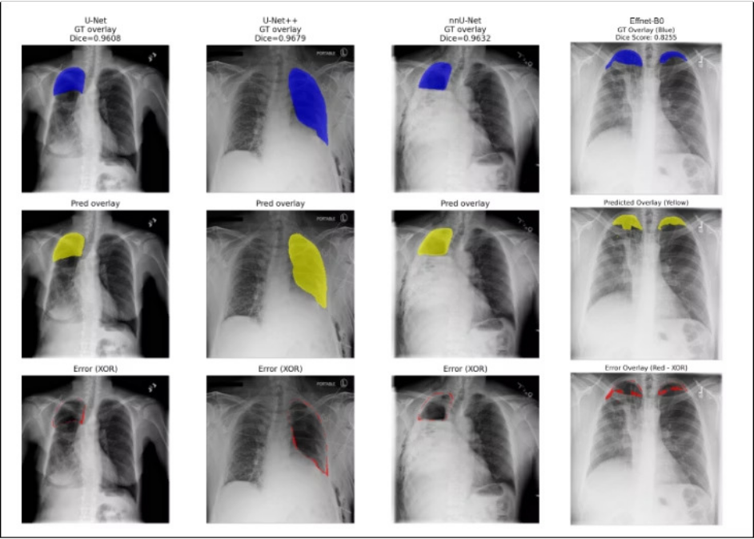
Qualitative Analysis (Best Case)
Color Legend
Blue 4 Ground Truth Actual pneumothorax region annotated by experts.
Yellow 4 Prediction Model-generated pneumothorax mask.
Red 4 Error (XOR) Mismatch between GT and prediction (false positives & false negatives).

Slide 23
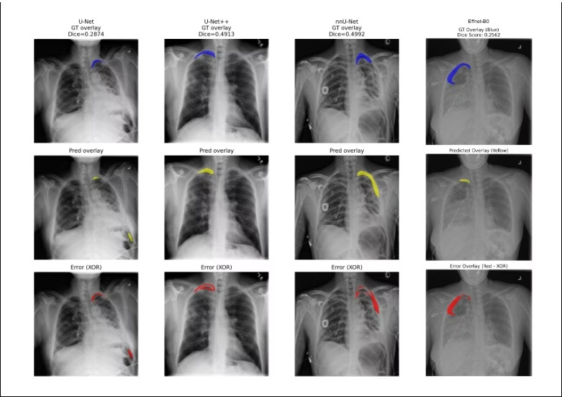
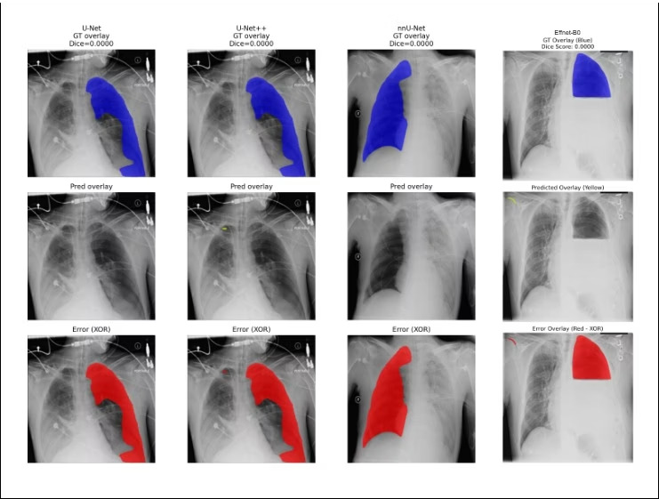
Qualitative Analysis
Median case
Worst case

Slide 24
Quantitative Analysis
Model Used
Encoder
Decoder
Paramet er (in M)
DSC
IoU
Sensitiv ity
Specific ity
UNet-ResNet34-256
ResNet34
Unet
24.44M
0.8431
0.7904
0.6196
0.9844
UNetPlusPlus-ResNet34-256
ResNet34
Unet++
26.08M
0.8561
0.7764
0.7069
0.9792
nnUNet-ResNet34-256
ResNet34
MAnet
31.78M
0.8520
0.7932
0.7174
0.9747
UNet-EffNetB0-256-Fast
EfficientNet-B0
U-Net
12M
0.3080
0.6851
0.9448
0.3161
PTXSegNet-HighRes
Pretrained Autoencoder
PTXSeg-Net
37M
0.4156
0.6945
1.0000
0.9563
UNet-R50-1024-Focal
Resnet50
U-Net
43M
0.7886
0.7886
0.7584
1.0000
UNet-EffNetB4-1024-Focal
EfficientNet-B4
U-Net
33M
0.7857
0.7857
0.5034
0.9963

Slide 25
State of the Art Comparison
Model Used | Encoder | Decoder | DSC | Year
PTXSegNet- | Pretrained | PTXSeg-Net | 0.9124 | 2025
HighRes | Autoencoder
Vanilla Unet | ResNet34 | U-Net | 0.7950 | 2024
UNet-R50-1024- Focal | ResNet50 | U-Net | 0.8400 | 2021
UNet-EffNetB4- | EfficientNet-B4 | U-Net | 0.8547 | 2021
1024-Focal

Slide 26
Performance Analysis by Model Category
Baseline Architectures (U-Net, U-Net++, nnU-Net)
Strong, consistent performance across all metrics (Dice >0.84, specificity >0.97). U-Net++: Best Dice (0.8561) and strong recall (0.7069).
nnU-Net: Highest sensitivity and lowest false negatives.
Reliable for clinical decision support and accurate boundary segmentation.
PTXSegNet-HighRes
Perfect case detection (100% recall) but poor Dice (0.4156).
Detects presence reliably but struggles with precise boundary localization. Useful for screening, not for detailed quantification.
Lightweight Model (EffNet-B0-256)
High sensitivity (0.9448) but very low specificity (0.3161) ³ too many false positives. Not suitable for clinical deployment despite good detection capability.

Slide 27
Conclusion
U-Net, U-Net++, and nnU-Net demonstrated clinically reliable performance, achieving Dice scores > 0.84 and strong sensitivity for pneumothorax detection.
U-Net++ proved to be the best overall model, while nnU-Net provided the highest recall with the fewest missed cases. The system successfully enables severity class detection, supporting clinical decision-making.
Failure modes in focal-loss models and PTXSegNet-HighRes highlight the importance of robust validation, stable loss functions, and careful architectural design.
Future Goals
Reduce false negatives through improved loss functions and sensitivity-focused architectures. Perform multi-center external validation to ensure generalizability across institutions.
Develop end-to-end workflow integration with PACS, real-time deployment features, and regulatory compliance. Conduct prospective clinical trials to evaluate real-world safety and effectiveness.

Slide 28
References
Khalid, S., et al. (2022). Pneumothorax Segmentation from Chest X-Rays Using U-Net / U-Net++ Architectures.
Zhan, X., et al. (2022). Pneumothorax Segmentation of Chest X-rays using Improved UNet++.
Rahman, M., et al. (2021). Chest X-ray Pneumothorax Segmentation using U-Net with EfficientNet / ResNet Encoders.
Zhang, Y., et al. (2020). 2ST-UNet for Pneumothorax Segmentation (ResNet-34 backbone + 2-stage training) .
Ronneberger, O., Fischer, P., & Brox, T. (2015). U-Net: Convolutional Networks for Biomedical Image Segmentation.
Zhou, Z., Siddiquee, M. M. R., Tajbakhsh, N., & Liang, J. (2018). UNet++: A Nested U-Net Architecture for Medical Image Segmentation.
Isensee, F., Jaeger, P. F., Kohl, S. A. A., Petersen, J., & Maier-Hein, K. H. (2021). nnU-Net: Self-adapting Framework for U-Net-Based Medical Image Segmentation.
He, K., et al. (2016). Deep Residual Learning for Image Recognition (ResNet).
Tan, M., & Le, Q. (2019). EfficientNet: Rethinking Model Scaling for Convolutional Neural Networks.
SIIM-ACR Pneumothorax Segmentation Dataset. Society for Imaging Informatics in Medicine (SIIM) & American College of Radiology (ACR).

